Slide 1
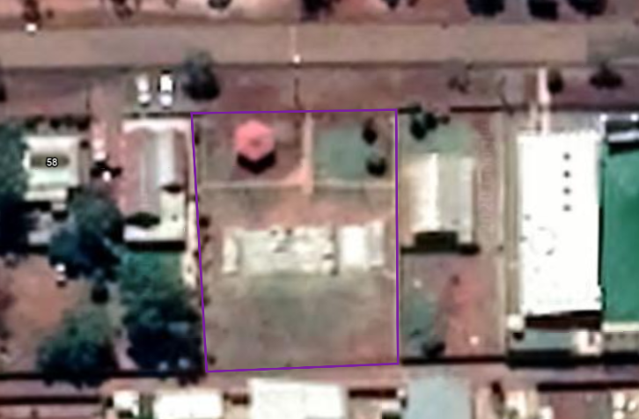
imagery: Google, ©2021 CNES / Airbus, Maxar Technologies
Leonora Skate Park
• How many trees are there?
Initiative of and funded by the Australian Government Department of Education, Skills and Employment

Slide 2
Leonora Skate Park
• How many trees are there?
imagery: Google, ©2021 CNES / Airbus, Maxar Technologies
Tree images added using PowerPoint icons
Initiative of and funded by the Australian Government Department of Education, Skills and Employment

Slide 3
Leonora Skate Park
• Where could we plant trees?
imagery: Google, ©2021 CNES / Airbus, Maxar Technologies
Tree images added using PowerPoint icons
Initiative of and funded by the Australian Government Department of Education, Skills and Employment

Slide 4
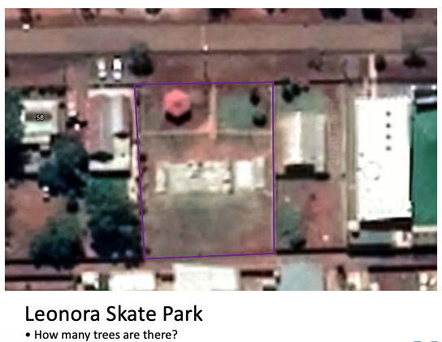
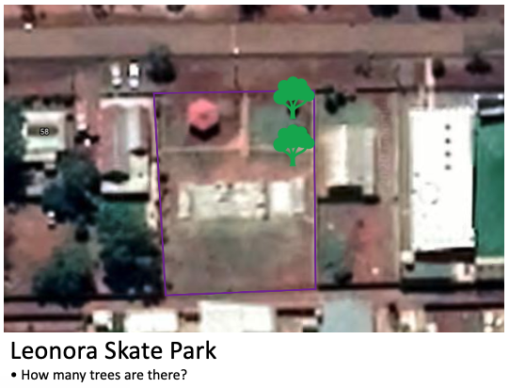
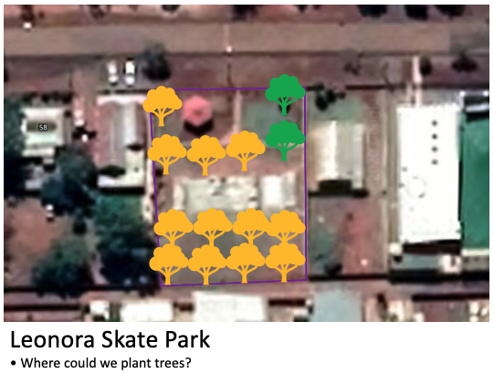
Step 1
Step 2
Step 3
Maps – imagery: Google, ©2021 CNES / Airbus, Maxar Technologies
Tree images added using PowerPoint icons
Initiative of and funded by the Australian Government Department of Education, Skills and Employment

